Slide 1
MRI BASIC SYSTEM OVERVIEW
2014 Leadership Meeting

Slide 2
Objectives:
To develop a basic understanding of the major components of an MRI system
To understand how a magnet is made and works

Slide 3
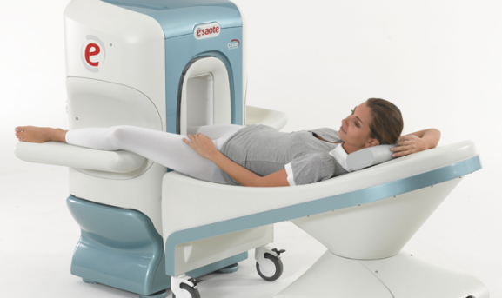
Types of Magnets
Resistive
Magnets that are created by connecting it to a current source.
They use electricity to generate the magnetic field.
Very low fields 0.2-0.3T.
Low power and site requirements .
Can easily be de-energized.

Slide 4
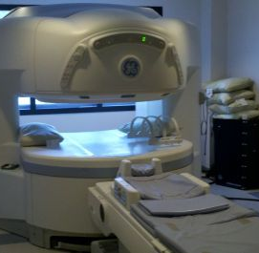
Types of Magnets
Permanent
Magnets made out of magnetic permanent materials (rare earth).
The major advantage is the low cost since magnet is always present and does not need cryogens or electricity.
Disadvantages include, weight, transport, low magnetic fields and disposing of the magnets.
Usually 0.2-0.45T (Low field)

Slide 5
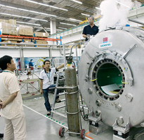
Types of Magnets
Superconducting
Electromagnets made from coils of superconductive wiring.
The coil needs to be immersed in cryogens and cooled to cryogenic temperatures in order to create the magnetic field by inducing a current and keeping the resistance at zero.
Very high fields 0.5T-20T.
High cost due to cryogens
Safety risk derived from high fields, cryogens and quenches.

Slide 6
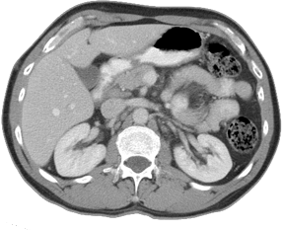
Magnetic Resonance Imaging System
Subject to be Imaged
Energy Source to be Detected
Energy Detection Device
Image Reconstruction Mechanism
Image Display Device
Coldhead
Image Display
Energy Source
RF Transmitter
Gas He
Patient
Exam
Smith, P.
Normal pressure ≈ 4 psi (± .1 psi)
Chest
Date
1/1/2014
Reference
Sequence
Slice mm 2
Data flow
Liquid Helium
-452 F°
4K
Liquid He
Vacuum
Energy Detection
RF Receive Coil
Image Reconstruction

Slide 7
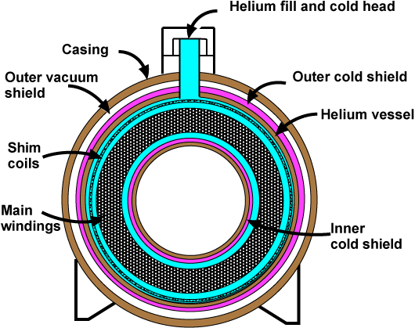
Magnet Vessel

Slide 8
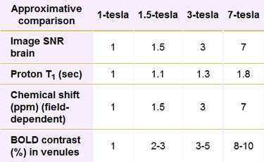
Tesla
1 Tesla = 10,000 Gauss
Earth magnetism 0.5 gauss
Most magnets are 30,000 to 60,000 stronger than the earth magnetic field
Most magnets 1.5T, a few 3T some old 1T
Many 7T or higher are for clinical research around the world right now. Mostly universities and research hospitals

Slide 9
Basic Functional Components of any Magnetic Resonant Imaging System
Magnet
Energy Source
Spatial Encoding
Energy Detector
System Functions
Computing
Gradients
Systems Operations
RF
System
Imaging
Coldhead
Compressor
Lines
Chiller
RF Power Supply
RF Amp
Gradient Power Supply
Gradient Amps (X,Y,Z)
Surface Coil
Body Coil
T/R Coil
Movements
System Interface & Connectivity
Safety
System Operation
Applications
Reconstruction
Communications
Image Display
PACS

Slide 10

Vent Stack
Patient
Smith, P.
Exam
Chest
Date
1/1/2014
Reference
Host
Sequence
Slice mm 2
Imaging
Magnet
Gradient Coils
Systems
Cabinet
RF Coil
Penetration Panel
Surface Coil
Patient Table
RF Coil
Gradient Coils
Magnet
Gradient Amplifier
X
RF Shield/Faraday Cage/Screen Room/Enclosure/Scan Room
Gradient Amplifier
Y
Gradient Amplifier
Z
RF Power Supply & Amplifier
Gradient Power Supply

Slide 11
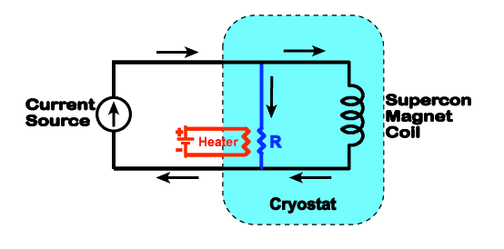
How do we make a magnet?
During ramping, a heater circuit is turned on causing a finite resistance to develop in resistor R. Once current begins to flow, the heater is turned off, and the resistance of R falls to zero, allowing the current to continue indefinitely through the superconducting loop in "persistence mode".
Ramping the magnet - Questions and Answers ​in MRI (mri-q.com)

